Slide 1
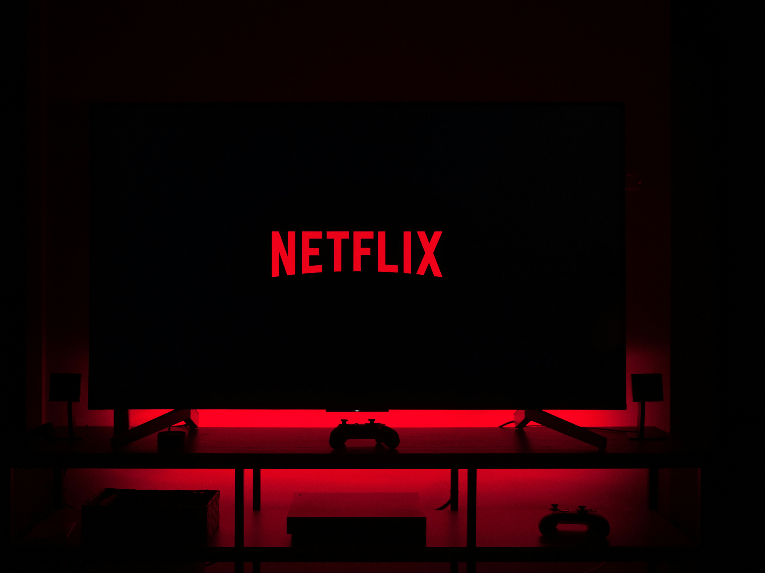
How Does Netflix Recommend Movies to You?
Minju Kim (Kimmy)
Notes:
Today, I’ll explain how Netflix organizes data and personalizes recommendations.

Slide 2
How Netflix Uses Data to Recommend Content?
IN SCOPE: data of Netflix uses for recommendations
OUT OF SCOPE: personal user information
✨UNIQUE POINT✨
Netflix does NOT ask for manual preference 🙅🏻‍♀️
It only tracks user behavior 🙆🏻‍♀️

Slide 3
Guide Principle: How Netflix Structures & Organizes Content
🎬 Movie Metadata (Title, Genre, Director)
📊 User Engagement (Watch time, Rating, Clicks, Completion %)
🤖 AI Model Learns
🍿 Recommends Movies
Notes:
Netflix structures its data using metadata and categorization to enhance recommendations

Slide 4
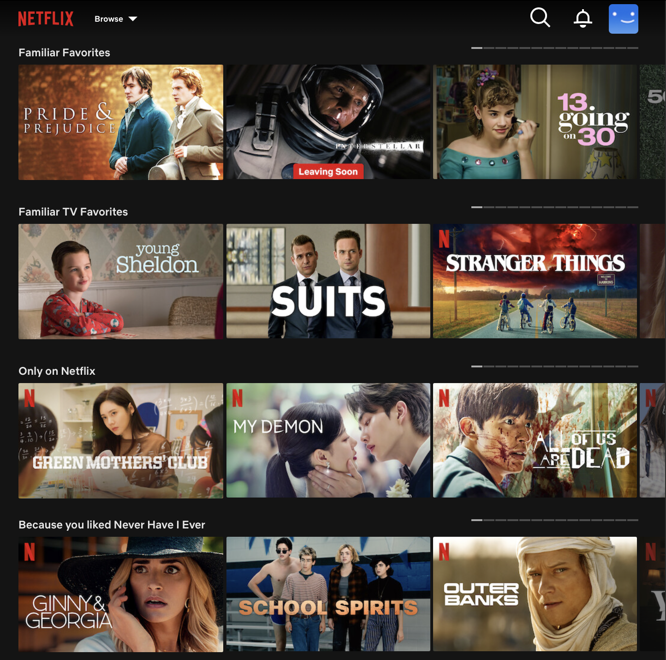
Authority Control: How Netflix Categorizes Content
Universal Classification
System
Dynamic Tags & Categories
Genres are NOT fixed→ Personalized dynamically based on user behavior

Slide 5
Identifiers Used: How Netflix Tracks Movies & Users
Movie ID: Tracks and categorizes every movie
User ID: Helps personalize recommendations
Device ID & Viewing Session ID: Ensures seamless streaming across devies
Identifier Type | Examples
Movie ID | Stranger Things → #101234
User ID | User Profile → #987654
Viewing Session ID | Tracks where you passed a show

Slide 6


How Netflix Recommend System Works?
Content-Based Filtering 🎬: Recommend similar movies
🔗 Same Director & Genre 🔗
Collaborative Filtering 👥: Finds users with similar tastes
Hybrid Model 🔗: Combines both methods
Notes:
If you watch Inception, Netflix suggests Interstellar (same director, genre). It also analyzes users with similar tastes to recommend popular choices.

Slide 7
CONCULSION
User Behavior Tracking
ML Algorithms
Hybrid Model
Personalized
movie recommendation
Notes:
Netflix’s recommendation system is more than just movie suggestions—it’s a powerful example of how data shapes our digital experiences

